Slide 1
Paper No. SPE-182707-MS
Low-dimensional tensor representations for the estimation of petrophysical
reservoir parameters
Edwin Insuasty , Eindhoven University of Technology (EUT), Paul Van den Hof, EUT, Siep Weiland, EUT, Jan-Dirk Jansen, Delft University of Technology.

Slide 2
Slide 2
Introduction
Setting: Computer-assisted history matching (CAHM)
Topic: Reparameterization of petrophysical gridblock properties (permeabilities, porosities)
Motivation:
  CAHM of grid block parameters is an ill-posed problem; therefore we need regularisation (usually in Bayesian framework with a prior ensemble)
  Reparameterization to reduce the number of parameters to be matched
  is an alternative to regularization
  Reparameterization in terms of the dominant spatial patterns of petrophysical parameters helps to build better priors

Slide 3
Slide 3
Earlier Reparameterization Studies (Incomplete List)
Zonation (Jacquard & Jain 1965; Jahns 1966)
Pilot points (de Marsily et al. 1984; Bissell et al. 1997)
Principal Component Analysis (PCA) (Gavalas et al. 1976, Oliver 1996; Reynolds et al. 1996; Tavakoli et al. 2010)
Kernel PCA (Sarma et al. 2008; Ma & Zabaras, 2011)
Optimization-based PCA (Vo & Durlofsky, 2014, 2015)
Level sets (Dorn & Villegas, 2008)
Wavelets (Lu & Horne, 2000; Sahni & Horne, 2005; Awotunde & Horne, 2013)
Discrete Cosine Transform (DCT) (Jafarpour et al. 2009, 2010; Zhao et al. 2016)
Tensor decompositions (Afra & Gildin, 2013, 2014, 2016; Afra et al. 2014)

Slide 4
Slide 4
Tensor Representation of Gridblock Properties
Classical representation:
  Gridblock parameters vectorized
  Vectors combined in a matrix
  Spatial structure is destroyed
Tensor representation:
  Reservoir realizations are stacked
  in a separate dimension, without vectorizing the gridblock parameters
  For Cartesian grids

Slide 5
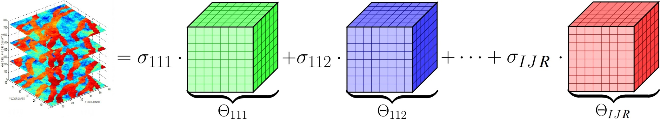
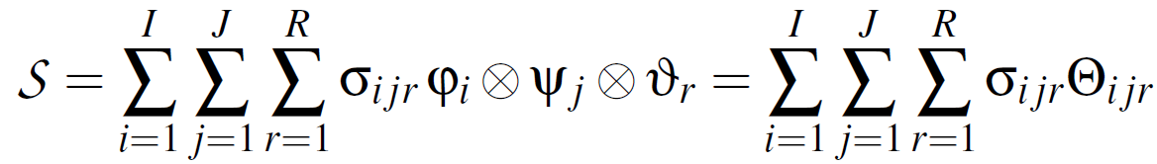
Slide 5
Tensor Decompositions
Linear combination of rank-1 tensors. Multilinear generalization of the SVD
Tucker decomposition:

Slide 6
Slide 6
Tensor Decompositons – Matrix Example
Example: Tucker decomposition of a 3 x 2 matrix via SVD:
Multilinear mapping (Here ; not always so)

Slide 7
Slide 7
Tensor Decompositons – Low Rank Approximations
Low-rank approximation of a matrix using a truncated SVD:
where is the Frobenius norm of matrix Z

Slide 8
Slide 8
Tensor Decompositons – Low Rank Approximations
Many “optimal” tensor decompositions and low-rank approximations.
We use the High-Order SVD (HOSVD) decomposition
(De Lathauwer et al. 2000):
Note: Results in a full core tensor; not diagonal
subject to the constraint that
are orthonormal

Slide 9
Slide 9
Low-Rank Approximation: SVD (Rank 30) and Tensor Decomposition
Example: 60 x 60 x 7 = 25200 gridblocks; 100 realizations of permeability
20.16 MB 12.17 MB (60.3%) 0.53 MB (2.6%)

Slide 10
Slide 10
Low-Rank Approximation: SVD (Rank 60) and Tensor Decomposition
Example: 60 x 60 x 7 = 25200 gridblocks; 100 realizations of permeability
20.16 MB 12.17 MB (60.3%) 0.53 MB (2.6%)

Slide 11
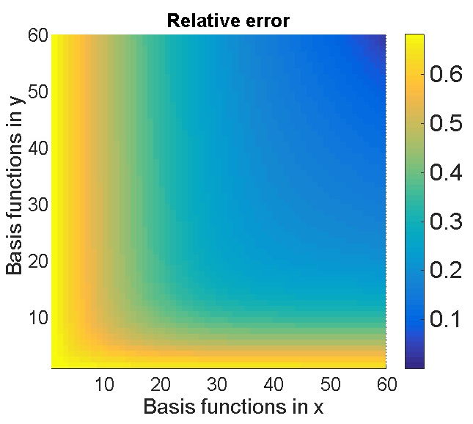
Slide 11
Directional Approximation Errors
    Approximation of the y coordinate requires fewer basis functions than the one for the x coordinate to achieve the same error
    Related to channel orientation
    Gives opportunity to selectively truncate

Slide 12


Slide 12
Tensor Reparameterization of Grid Block Parameters
Low-rank tensor approximation of one realization:
where
All the realizations share the
same basis functions!
Parameterization through
letting the coefficients
be free parameters.

Slide 13

Slide 13
General Formulation of EnKF With Tensor Parameterization
Reservoir model: and model output ,
: reservoir states (pressures, saturations)
: control variables (bottom hole pressures, well rates)
: petrophysical parameters (perms, porosities)
Augmented state vector
where a is the vector
of parameters

Slide 14
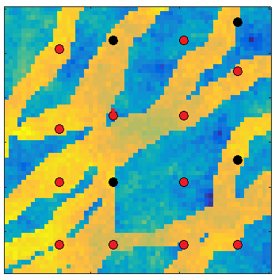
Slide 14
Example
Model:
Stanford data set (3600 grid cells)
Ensemble size: 100 realizations
Waterflooding: 12 producers, 4 injectors
Computer Assisted History Matching:
Estimated parameter: Permeability
Simulation time: 15 years
Final update time: 6 year
Update time interval: 2 year
Measurement time interval: 3 month
(rates and pressures)

Slide 15
Slide 15
Example
Experiments:
CAHM with grid-based permeability
(3600 parameters)
CAHM with PCA parameterization
(50 parameters)
CAHM with tensor parameterization
(50 parameters)

Slide 16
Slide 16
Model Updates

Slide 17
Slide 17
Model Updates

Slide 18
Slide 18
Total rates: Well 5
Better predictions with parameterization
No clear benefit of tensor over PCA

Slide 19
Slide 19
Total Rates: Well 11
Better predictions with parameterization
No clear benefit of tensor over PCA

Slide 20
Slide 20
Water Cut: Well 9
Water breakthrough information
in the measurements

Slide 21
Slide 21
Water cut: Well 5
No water breakthrough information
in the measurements

Slide 22
Slide 22
Conclusions
Tensor representation of petrophysical grid block properties:
  Very efficient in terms of storage
  Maintains spatial properties much better than PCA
EnKF history matching with tensor representation:
  Channellized structure much better preserved than without parameterization or with PCA
  Improved prediction capabilities of the updated models:
  Some benefits compared to PCA, but not yet fully convincing (Too optimistic conclusion in paper)
  More experiments needed

Slide 23
Slide 23
Acknowledgements / Thank You / Questions
The authors acknowledge financial support from the Recovery Factory program sponsored by Shell Global Solutions International.

